Slide 1
Black Box Testing State Transition Testing

Slide 2
State Transition Testing
State transition testing is used where some aspect of the system can be described in what is called a 'finite state machine'.
This simply means that the system can be in a (finite) number of different states, and the transitions from one state to another are determined by the rules of the 'machine'.

Slide 3
Finite State Machine (FSM)
An FSM is a behavioral model whose outcome depends upon both previous and current inputs.
FSM models can be prepared for software structure or software behavior.
It can be used as a tool for functional testing.
Many testers prefer to use FSM model as a guide to design functional tests.
A finite state system is often shown as a state diagram

Slide 4
State Transition Testing
A state transition model has four basic parts:
the states that the software may occupy (open/closed or funded/insufficient funds);
the transitions from one state to another (not all transitions are allowed);
the events that cause a transition (closing a file or withdrawing money);
the actions that result from a transition (an error message or being given your cash).

Slide 5
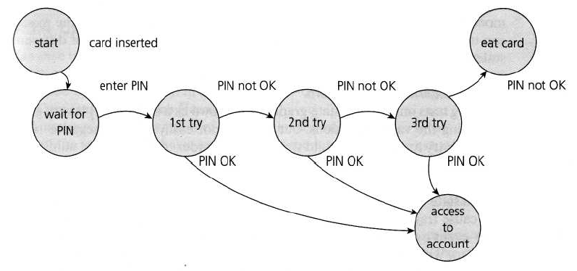
Example 1: State Transition Testing
States are represented by nodes. Now with the help of nodes and transition links between the nodes, a state transition diagram or state graph is prepared.
State Diagram for PIN Entry

Slide 6
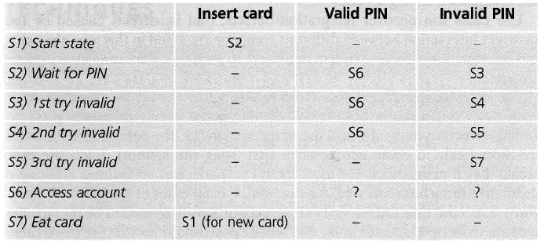
State Transition Testing
The following conventions are used for the state table :
Each row of the table corresponds to a state.
Each column corresponds to an input condition.
The box at the intersection of a row and a column specifies the next state (transition) and the output, if any.
State table for the PIN example

Slide 7
Example 2: Class Activity

Slide 8
Example 3: Homework
Consider a system having an FSM for a stack having the following states and transitions:
States
Initial: Before creation
Empty: Number of elements = 0
Holding: Number of elements > 0, but less than the maximum capacity
Full: Number elements = maximum
Final: After destruction
Transitions
Initial to Empty: Create
Empty to Holding, Empty to Full, Holding to Holding, Holding to Full: Add
Empty to Final, Full to Final, Holding to Final: Destroy
Holding to Empty, Full to Holding, Full to Empty: Delete
Design test cases for this FSM using state table-based testing.

